Slide 1
Image Search using Computer Vision
Group Number:- 15
Project Guide:- Prof. Deepali K. Jadhav
Group Members:-
Shamali Sathe
Saurabhsingh Thakur
Shital Kallole
Aditya Karmalkar

Slide 2
Problem Statement
Our aim is to develop a software that can help to find a specific persons image from a collection of images, given a persons image as input

Slide 3
Objectives
To reduce efforts required to search through the collection and find specific persons image
To save time in searching images

Slide 4
Existing System
Picasa
Flickr
Google Photos
Photoshop

Slide 5
Flow Chart - 1
Start
A
Feature Extraction
Input Image
Store Features in DB
Face Detection
Aligning
Stop
A

Slide 6
Flow Chart - 2
Start
A
C
B
Read Features from DB
If Next Image Available?
YES
Select Image from Collection
B
Is Input Image = Selected Image? / Face Recognition
NO
Face Detection
NO
Stop
C
Aligning
YES
Display Image
Feature Extraction
C
A

Slide 7
Modules
Face Detection
Aligning
Feature Extraction
Face Recognition
Image Sorting and Display

Slide 8
Algorithms
Haar Cascades (Viola-Jones) algorithm for Face Detection
Local Binary Pattern Histogram (LBPH) for Face Recognition

Slide 9
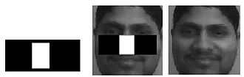

Modules
Face Detection

Slide 10
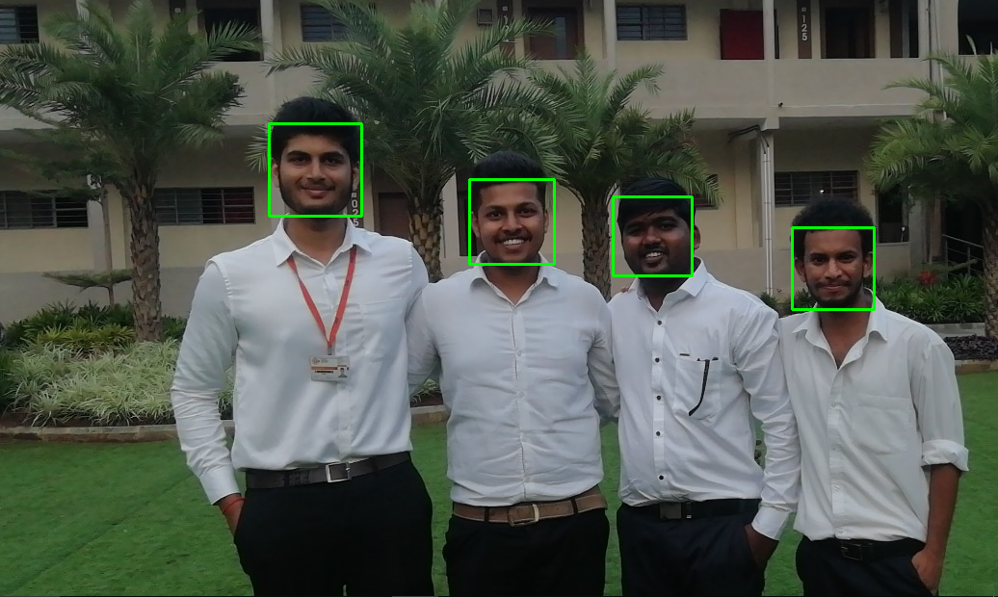
Modules(Implementation)
Face Detection Output

Slide 11
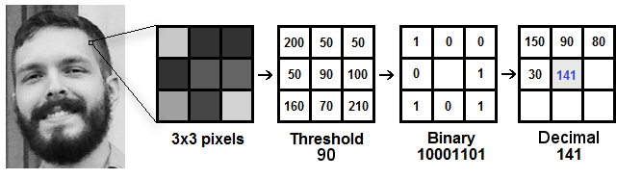
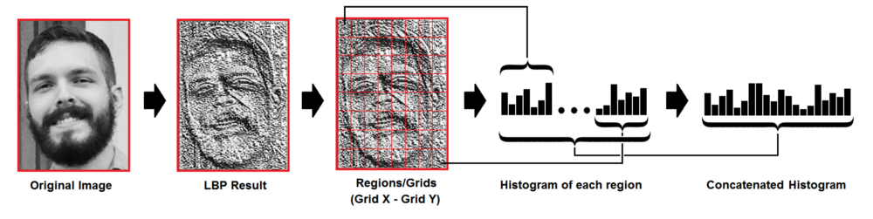
Modules
Feature Extraction

Slide 12
Technologies
Tensor Flow
OpenCV
Python

Slide 13
References
Paper on “A Comparative Study on Face Detection Algorithms” by Ramakrishna B. B. and M. Sharmila Kumari from International Conference on Energy, Communication, Data Analytics and Soft Computing(ICECDS-2017)
Paper on “Face Detection and Tracking using OpenCV” by Kruti Goyal, Kartikey Agrawal and Rishi Kumar from International Conferences on Electronics, Communication and Aerospace Technology(ICECA-2017)
https://en.wikipedia.org/wiki/Viola-Jones_object_detection_framework

